Slide 1
Reducing marking load
Tweet @unswpvce #ILS2019

Slide 2
Agenda
Rubrics and saving time in Turnitin (Dr Jasper Hsieh)
How STACK can reduce your marking load (Dr Felipe Crisostomo & Dr Qinyang Lei)

Slide 3
Rubrics and saving time in Turnitin
Dr Jasper Hsieh (Educational Developer, PVCE)

Slide 4
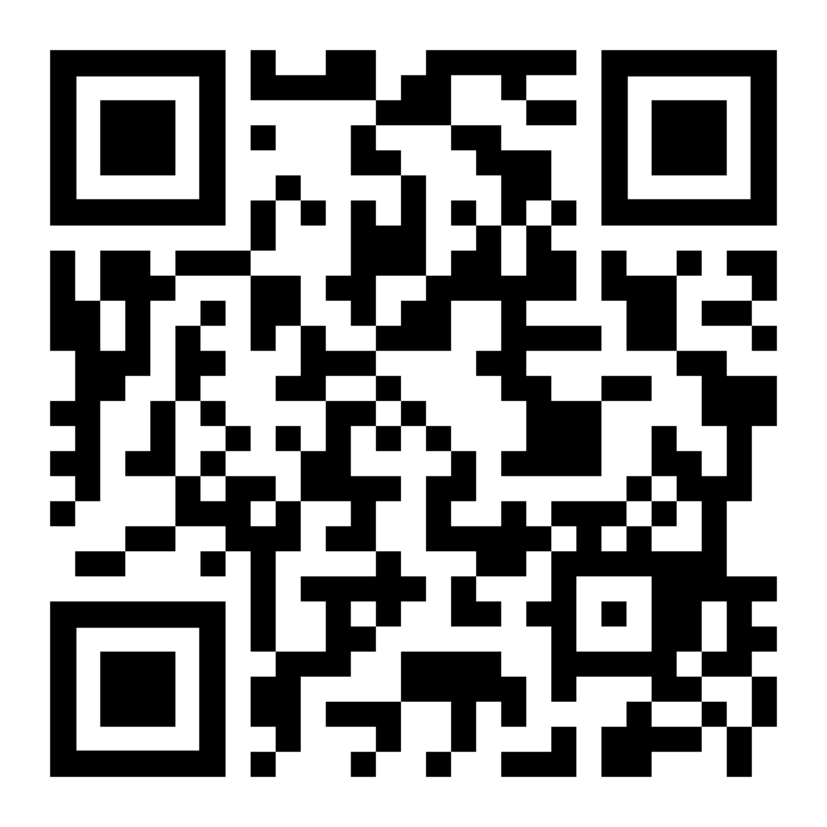
Before we start...
Scan this QR code
Or
www.slido.com > #ILS2019marking

Slide 5
Content
Why be collaborative with students in rubrics?
How to include students' voices?
What to do in Turnitin?
What
How
Why

Slide 6
Why being collaborative in rubric?
2018 Student Experience Survey (QILT)
30% FASS students are not happy with the use of rubric
- Ask questions and check if they understand rubric correctly
- A rubric with clear essay instruction
- A rubric contains the disciplinary's standards, not instructor's
The assessment is repetitive and the assessment criteria do not sufficiently state what content is necessary for what mark (they only state that "xx was done to a fair/good/excellent standard").

Slide 7
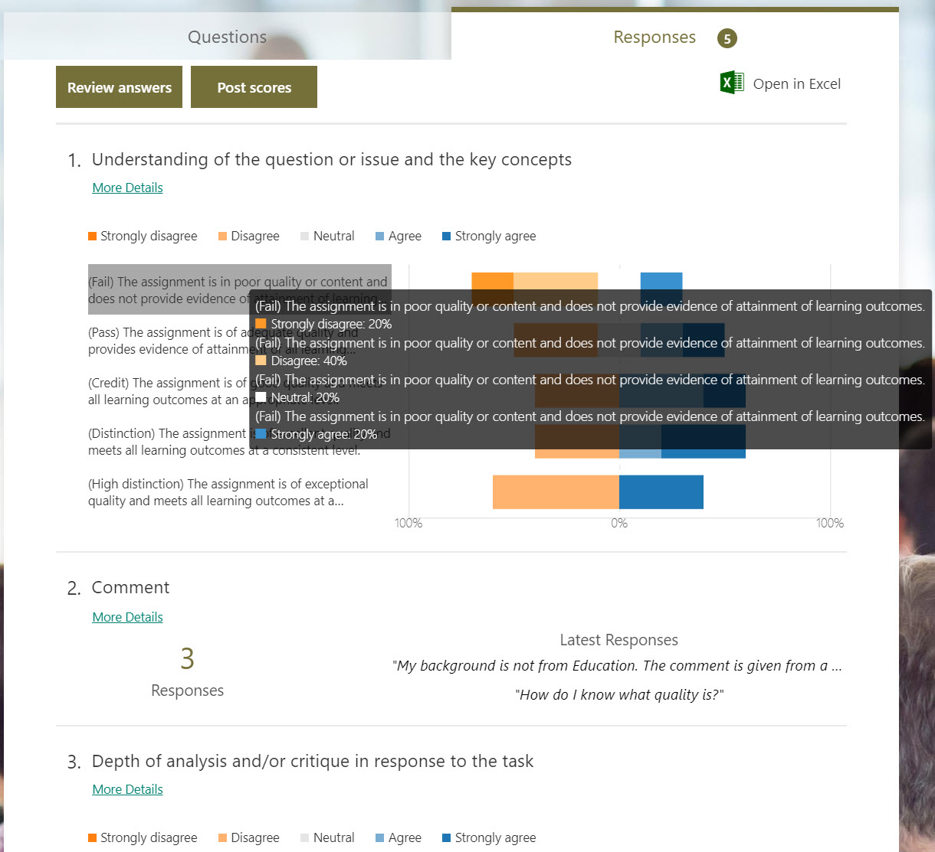
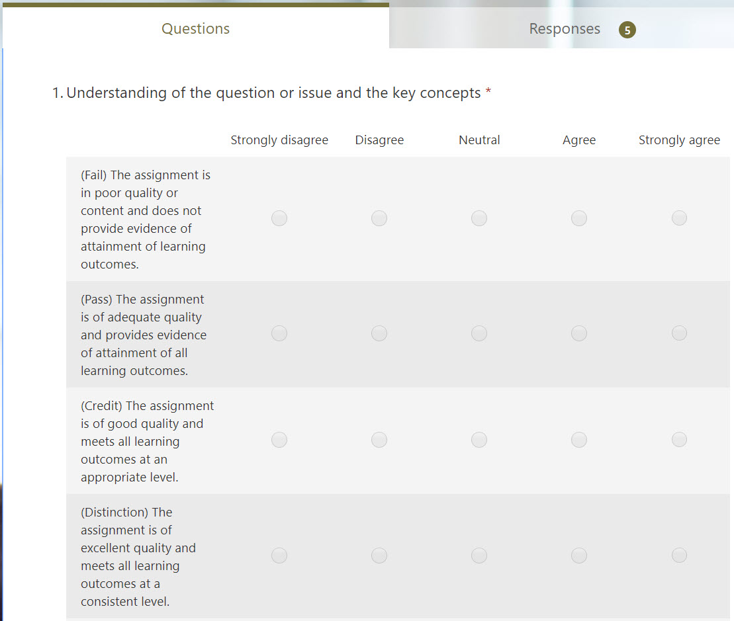
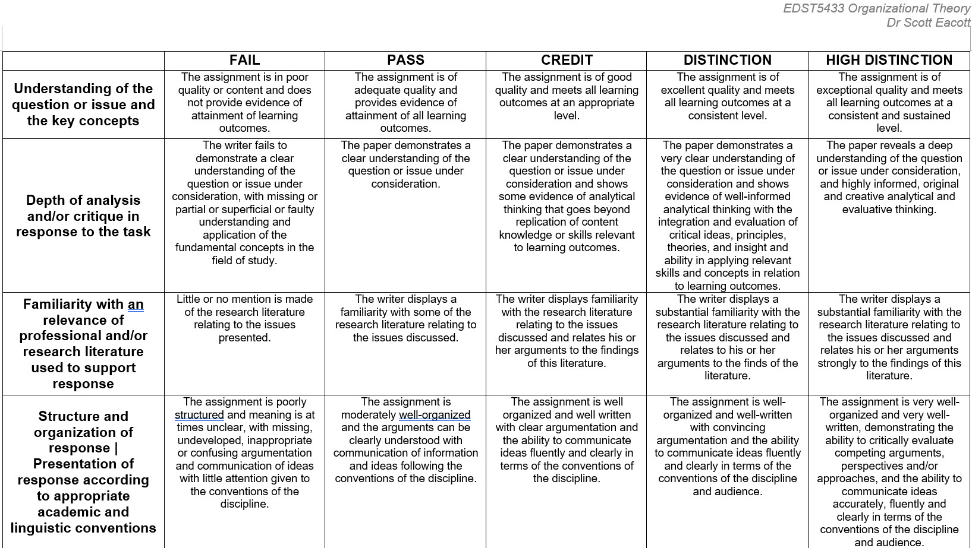

How to include students' voices?

Slide 8
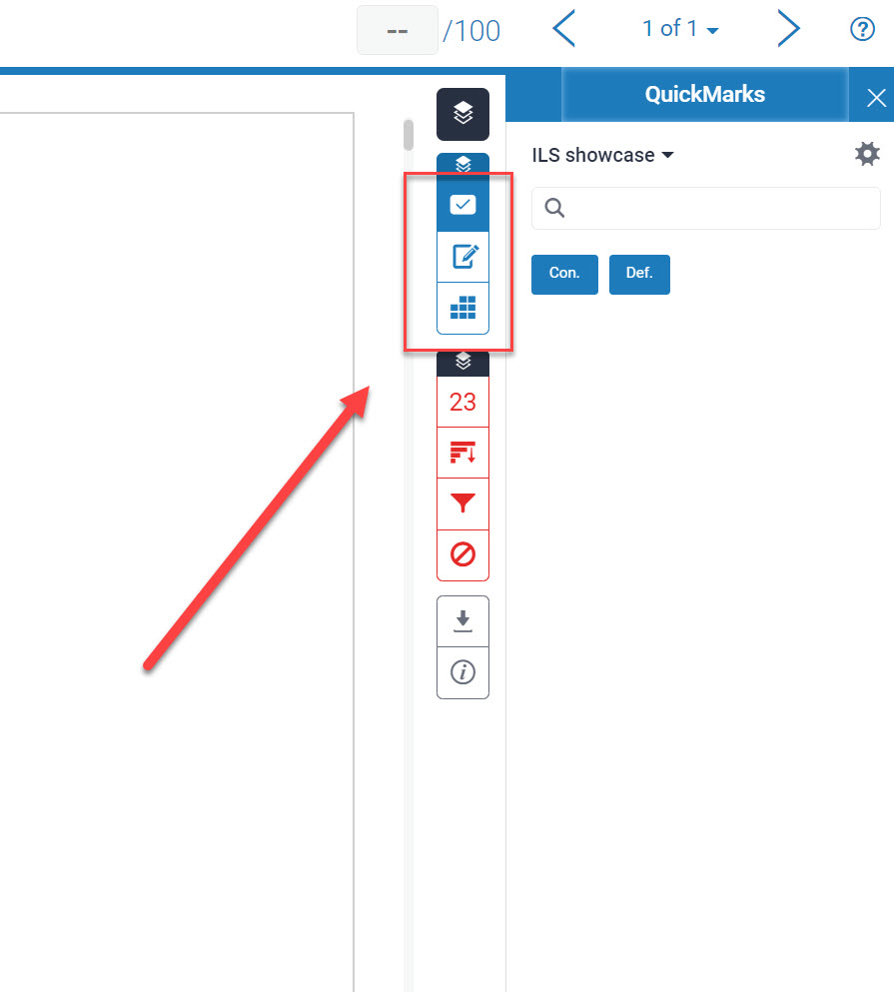
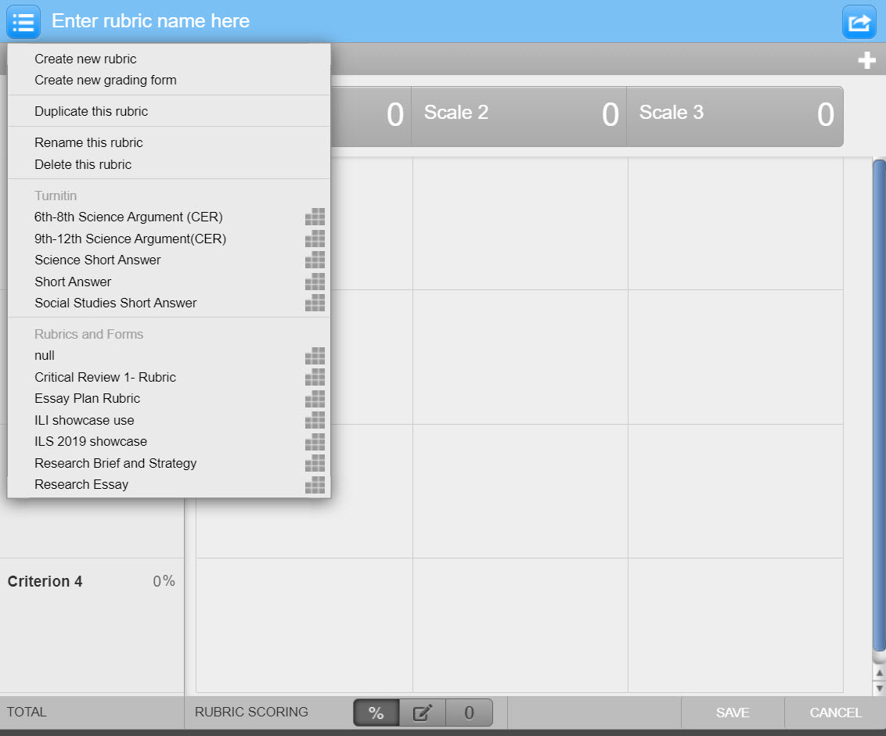
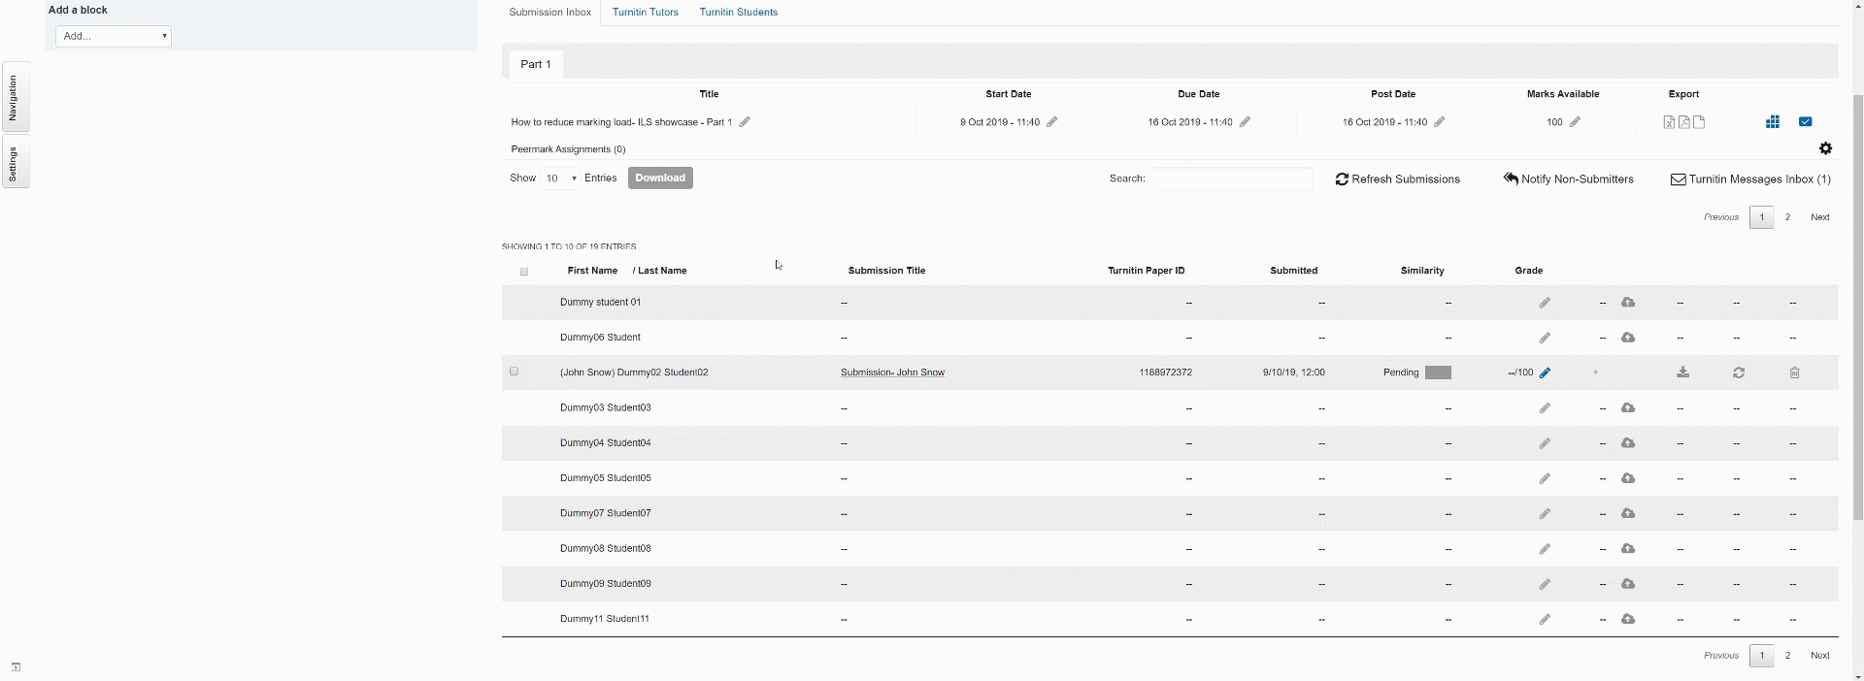
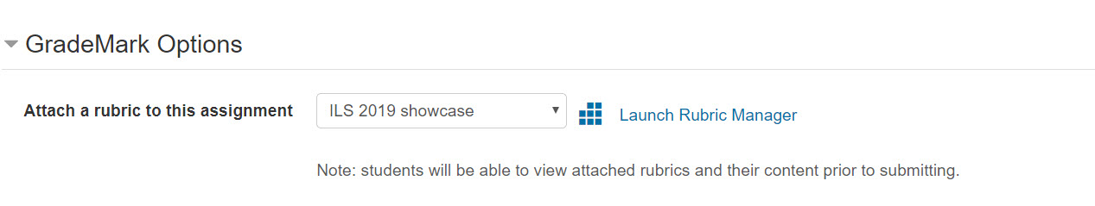
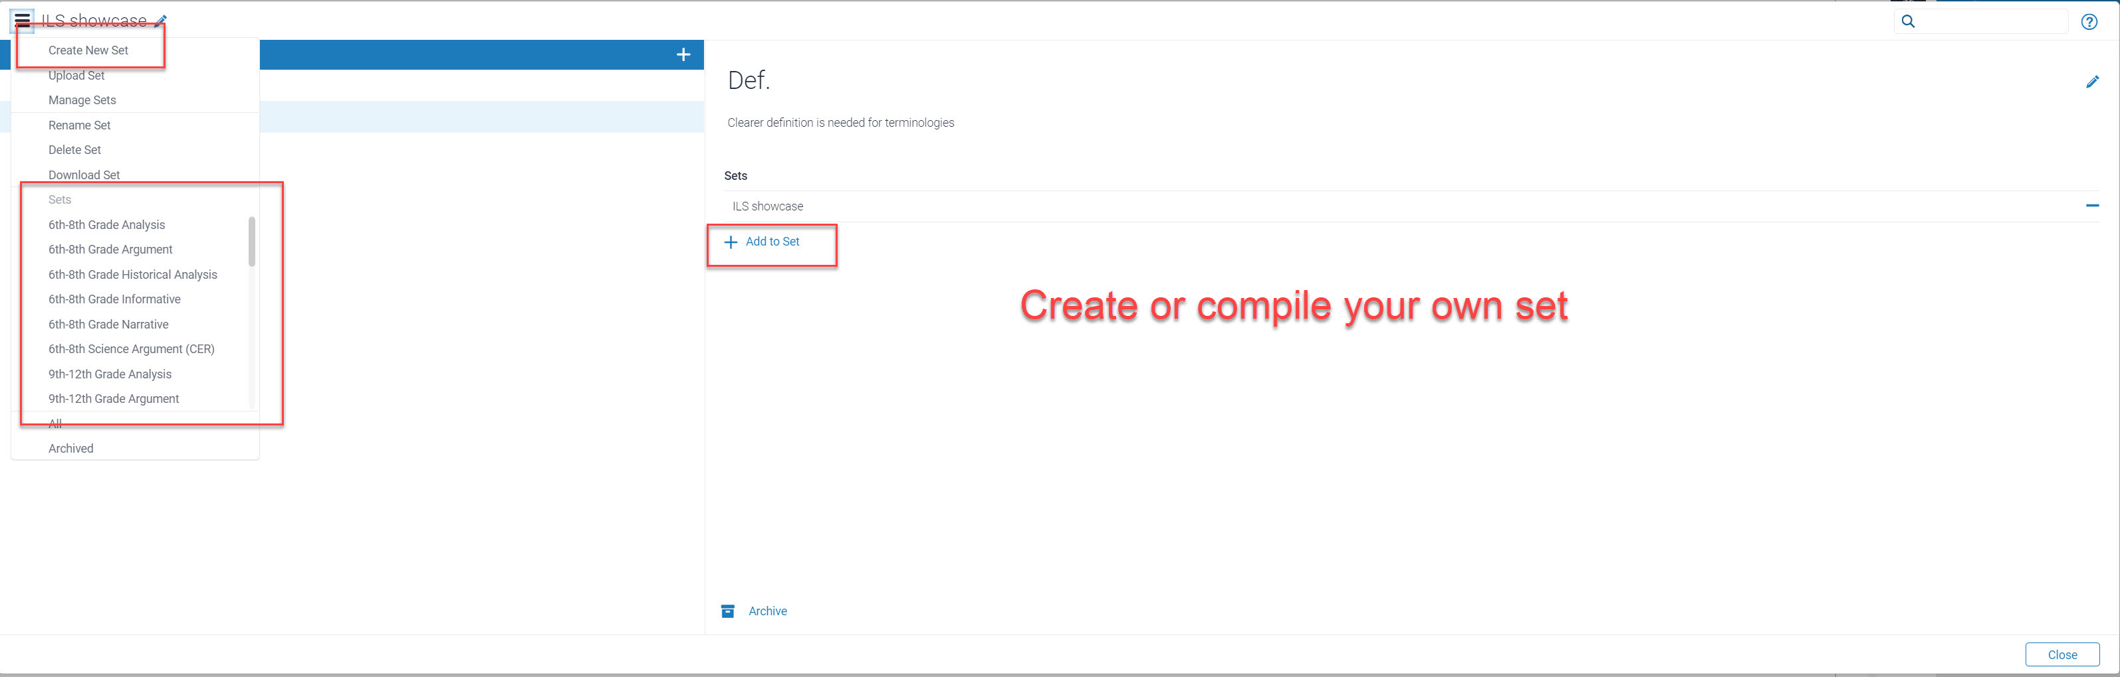
What to do in Turnitin
Turnitin > setting > GradeMark Option

Slide 9
Q&A
Teaching gateway on Turnitin: https://teaching.unsw.edu.au/moodle-staff-turnitin
RubiStar: http://rubistar.4teachers.org/index.php
Great teaching is created between method and madness

Slide 10
How STACK can reduce your marking load
Dr Felipe Crisostomo & Dr Qingyang Lei
Educational Developers, PVCE

Slide 11
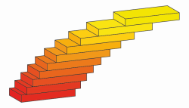
STACK – Quick overview
Free external Moodle plug-in
Available in every UNSW Moodle site
Syntax of the mathematical model (script) → CAS Maxima
Question text → HTML editor and LaTeX is supported

Slide 12
STACK – Key Features
Allows to run complex mathematical models and to randomise variables
Allows to set detailed marking rubrics
Ability to ask for algebraic expressions
Ability to take in account carry-over errors
Improved feedback dependent on student inputs

Slide 13
What’s next
We will showcase 4 STACK questions and will discuss their key features in relation to reduce your marking load

Slide 14
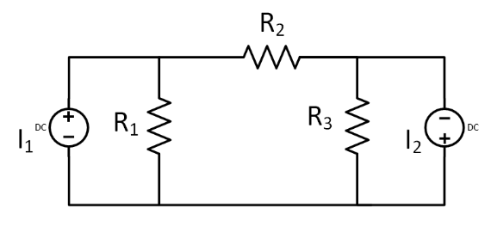
Question 1
https://moodle.telt.unsw.edu.au/question/preview.php?id=10006241&courseid=44984
Remarks:
Each student will get a different set of values for the currents and electrical resistors
~1/3 of the students are asked for values across R1, 1/3 across R2 and 1/3 across R3
Part (c) is marked partially correct if the calculation procedure is OK (carry over error)

Slide 15
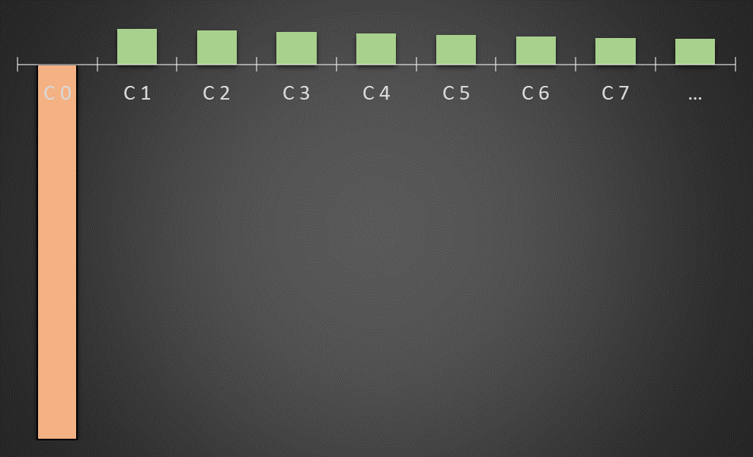
Question 2
https://moodle.telt.unsw.edu.au/question/preview.php?id=10006240&courseid=44984
Remarks:
Each student will get a different set of values for the initial investment, annual return, interest rate and period
Correct answer part b (drop-down) will depend on the combination of random values

Slide 16
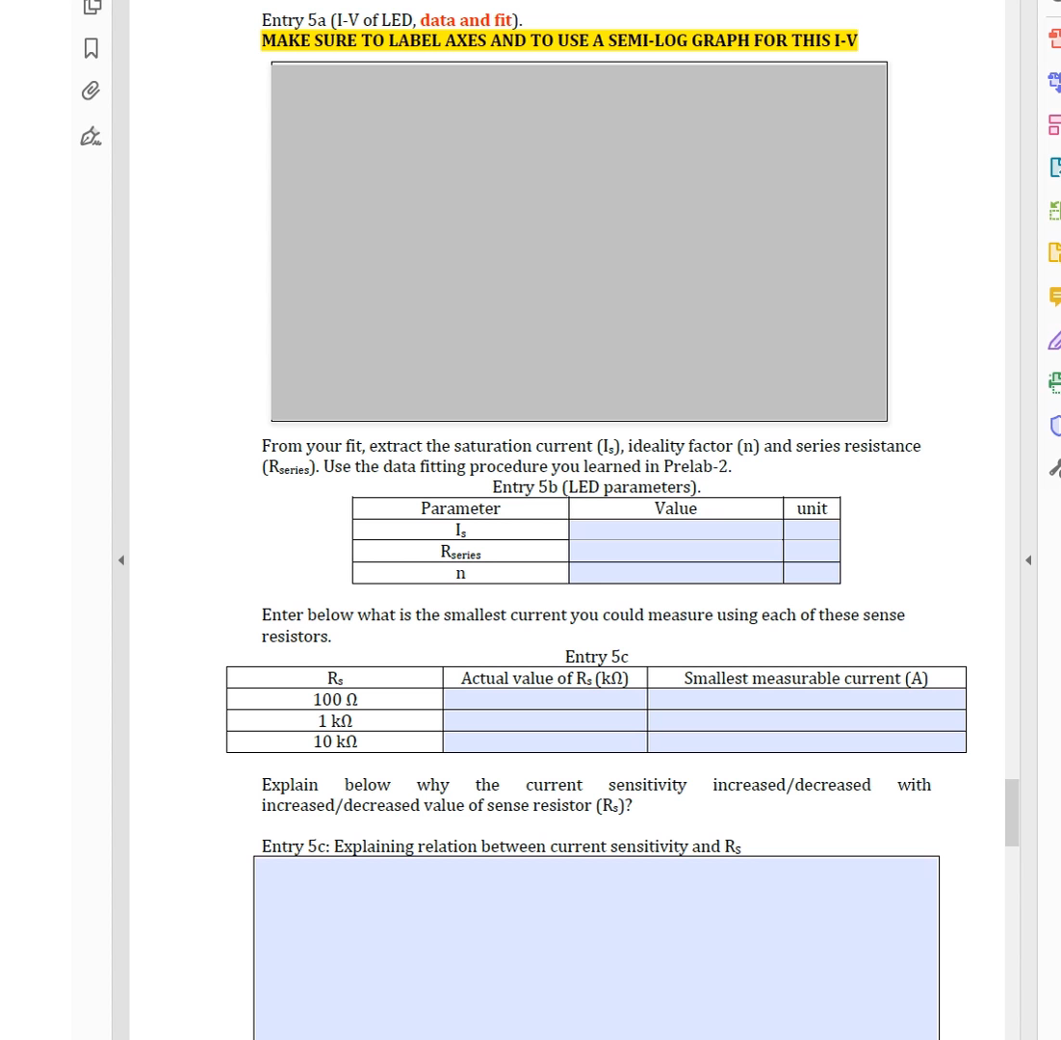
Data Fitting
https://moodle.telt.unsw.edu.au/question/preview.php?id=10017561&courseid=44984
Remarks:
This question is part of a digital lab report
Original report is in PDF format
STACK marks all (randomised) calculation-based questions in the report
Better & quicker feedback

Slide 17

Integration of GeoGebra
https://moodle.telt.unsw.edu.au/question/preview.php?id=10017652&courseid=44984
Remarks:
~500 enrolment this year
Many possible scenarios for this (randomised) question
Difficult to check each answer and give partial credit
STACK & GeoGebra can give partial credit according to pre-designed algorithm

Slide 18
Summary
What do you want to do? | Moodle question | STACK question
Graphical (Drag and Drop / Matching) questions | ⋆⋆⋆ | -
Single input numerical question (with tolerance) | ⋆⋆⋆ | ⋆⋆
Numerical question with random values | ⋆⋆ | ⋆⋆⋆
Pick typical mistakes in a numerical question (e.g. wrong units) | ⋆⋆ | ⋆⋆⋆
Take in account the carry-over error | ⋆ | ⋆⋆⋆
Multiple dependant numerical inputs within the same question | ⋆ | ⋆⋆⋆
Different types of inputs in the same question and set dependencies between them | ⋆ | ⋆⋆⋆
Ask for an algebraic expression | ⋆ | ⋆⋆⋆
Check student answers against expected behaviour (data fitting) and other external integrations | - | ⋆⋆⋆
Complexity
of the
question

